Slide 1
Introduction to JavaScript: Object- Oriented Programming
Week 03.

Slide 2
Objectives
Describe the basic structure of a Class in JavaScript;
Describe the concept of Object and its usage in Object-Oriented Programming;
Demonstrate how to create and use custom objects in JavaScript.

Slide 3
Tools Required
Visual Studio Code
Browser
Google Chrome (recommended)
Mozilla Firefox

Slide 4
What is Object-Oriented Programming?

Slide 5
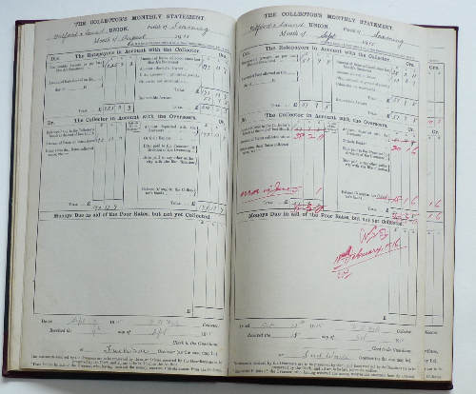

Before the Use of Computers…
Monthly statements of rates collected (1912 – 1920)
Old Barclays bank book. The page shown here shows all transactions in 1913!
Before the use of computers, transferring money from one bank account to another required the use of paper and pen.
Tons of papers were used to store information such as customers’ bank account(s) details, transactions of money transferred, etc.
It was a tedious, slow and painful job, and easily prone to human errors.

Slide 6
With the Use of Computers…
With the use of computers, transferring money from one bank account to another requires a way to represent such real world process in digital form.
There is no need for tons of papers to be used but there is still a need to store, manipulate and transfer data/information.
There is no need for using pen to record information but there is now a need to write computer programs to automate the whole process of money transfer.
Object-Oriented Programming provides a way to implement real world processes, such as the above, in the digital medium.

Slide 7
Object-Oriented Programming Languages
There are many languages that supports Object-Oriented Programming.
The following lists some of these languages:
Simula 67
Smalltalk
Java
C++
JavaScript
Python
C#

Slide 8
What is an Object?
An Object is something that we perceived in the real world that has states and behaviours.
For instance, in the previous example a Bank Account is an object that could have the following states:
Customer Name
NRIC
Account Number
Account Type
Amount
Activation
And the following behaviours:
Activate Account
Deactivate Account
Debit Amount
Credit Amount

Slide 9
What is an Object?
Another example of an Object is a Dog.
For instance, a Dog could have the following states:
Name
Breed
Gender
Age
And the following behaviours:
Barking
Wag the tail
Drinking
Jumping

Slide 10
Class Diagram
For documentation purpose, we can use a Class Diagram to represent Objects (so that it is easier to read) as shown in the following examples:
Class Name
BankAccount
Name: String NRIC: String AccountNumber: String AccountType: String Amount: double Activation: boolean
ActivateAccount() DeactivateAccount() DebitAmount() CreditAmount()
Dog
Name: String RegistrationNumber: String Breed: String Gender: char Age: int
Barking() WagTheTail() Drinking() Jumping()
States
Behaviours

Slide 11
How to use Objects?
In Object-Oriented Programming, we make use of Objects to group, transfer and manipulate data.
As you can see from the previous examples, the data/information of Bank Account and Dog are contained in their respective states.
The behaviours in each of them can be created to manipulate their data.
So how do we create Objects in our program to use them?
We will talk about this in the next section.

Slide 12
Object-Oriented Programming References
Wikipedia
https://en.wikipedia.org/wiki/Object-oriented_programming
IBM: Object-oriented programming concepts and principles
https://www.ibm.com/developerworks/library/j-perry-object-oriented-programming-concepts-and-principles/index.html

Slide 13
Object-Oriented Programming IN jAVAsCRIPT

Slide 14
How to Create Objects?
JavaScript has different ways to create Object.
We will use class declaration that is similar to Java, to implement Objects in JavaScript.
A Class is a blueprint for an Object that we write in code form.
We represent the states and behaviours of an Object using a Class in code form.

Slide 15
Running Server-side js
Javascript as a programming can be used in the client-side or the server-side
Until now, we had been trying out javascript in the browser. This is known as client-side javascript because it is the browser that process the javascript.
We will now be trying out server-side javascript and it will be nodejs that will be running the javascript file instead of the browser
For that we would need to use the nodejs that you had previously installed

Slide 16
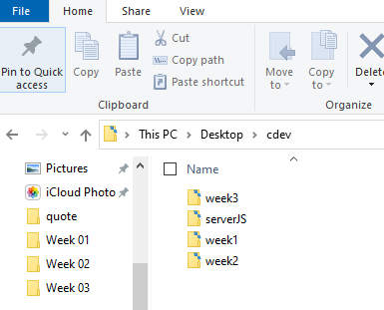
Running Server-side js
Create a folder in your cdev folder and name it as “serverJS”
Open VS code and choose open Folder and browse to “serverJS
Run the following command in the terminal “npm init”
Watch the demo video here

Slide 17
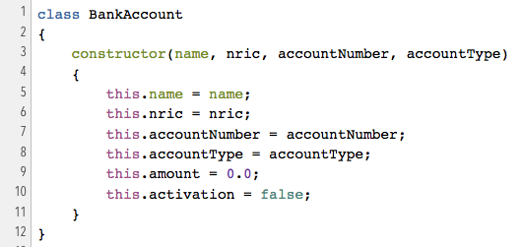
How to Create Object States?
Let’s start with creating a BankAccount class and its states first.
Under your website folder, create a folder called models.
Under the models folder, create a file called BankAccount.js.
Object states are created using variables.
Add the code on the right to the BankAccount.js file.
Notice that in JavaScript, the constructor is a keyword and the state variables are created in the constructor.
In the next slide, we will compare the differences between Java and JavaScript.

Slide 18
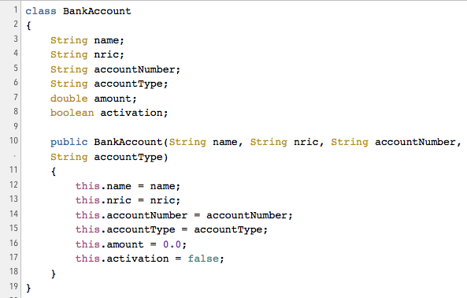
How to Create Object States?
Java
JavaScript

Slide 19
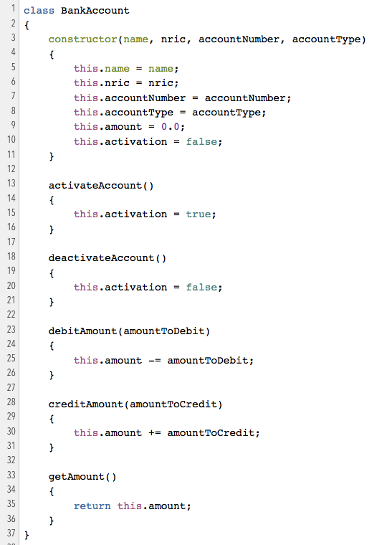
How to Create Object Behaviours?
Object behaviours are created using method / function.
Let’s now add the behaviours as shown on the right into the class.
In the next slide, we will compare the differences between Java and JavaScript.
Behaviours

Slide 20
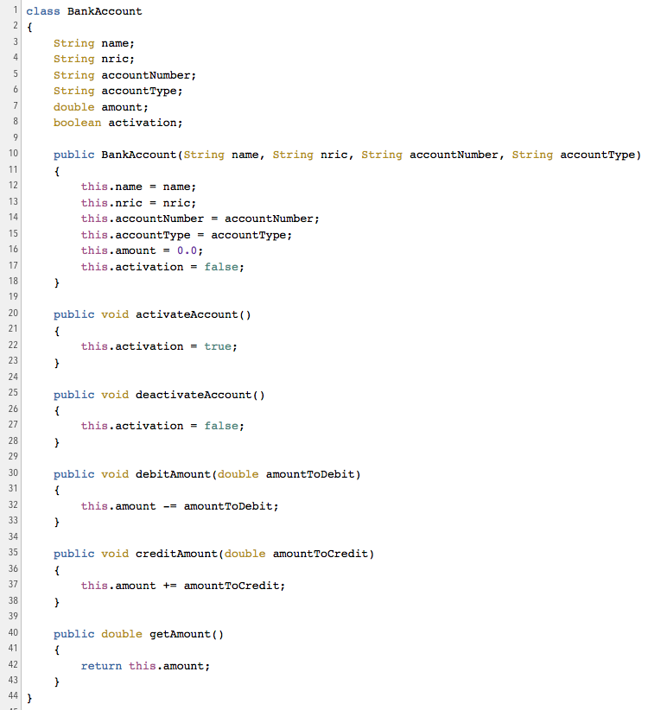
How to Create Object Behaviours?
Java
JavaScript

Slide 21
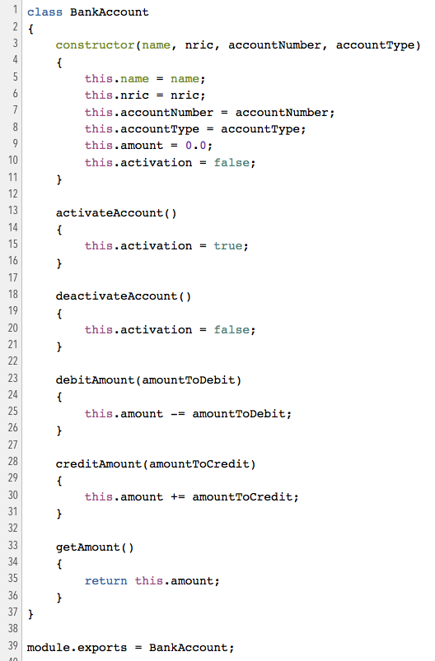
Test It Out
To test if your class works, it is good practice to create a separate testing file.
create a new file called test.js.
In JavaScript, in order to use the BankAccount class in test.js, you need to export the class from BankAccount.js.
Open the BankAccount.js file to add the highlighted line as shown on the right.
Continue to next slide…
Add this line here.

Slide 22
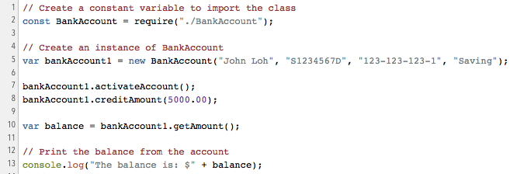
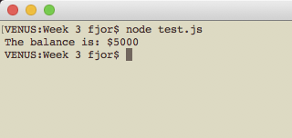
Test It Out
Open the test.js file to add the codes on the right to test your class.
After you save the file, open up your Command Prompt or Terminal and change directory to your models folder.
Type the following to run your program:
node test.js

Slide 23
Try It Out!
Add additional functions to BankAccount.js to do the following:
Get the name of the account holder
Get the account type of the account holder
In your test.js file, write the codes to debit $250.00 from the amount of John Loh in the example.
Print out the name of the account holder, the account type and the balance to the console.
Notes:
var radius = 3;
var circumference = Math.PI * 2*radius;
console.log("The circumference is " + circumference);
var area = Math.PI * radius*radius;
console.log("The area is " + area);

Slide 24
Challenge
Add an additional function to BankAccount.js to transfer amount to another account. The function name can be “transferAmount”.
The function should have two parameters:
Amount to transfer
The account to transfer to
In your test.js file, write the codes to create another instance of BankAccount with the following info:
Name: Elsa Goh
NRIC: S7654321D
Account Number: 113-113-113-2
Account Type: Saving
Activate Elsa Goh’s account
Credit $5000.00 into Elsa Goh’s account
Transfer $50.00 from John Loh’s account to Elsa Goh’s account.
Print out the balance of both accounts to the console.
Notes:
var radius = 3;
var circumference = Math.PI * 2*radius;
console.log("The circumference is " + circumference);
var area = Math.PI * radius*radius;
console.log("The area is " + area);

Slide 25
The End

